Slide 1

Presentation of Travel Insurance

Slide 2
About the dataset :-
This dataset we found on kaggle consists 60764 rows and 11 columns.
This dataset is a third-party travel insurance service company which is based in Singapore.
Anyone can use this dataset to analyse the Amount of sales of travel insurance policies and how much Commission received the travel insurance agency .
Project Overview :-
The main object is to use differet type of machine learning algorithms and to check the valuable insights, patterns, and trends .
The aims of the Travel Insurance dataset is to predict (Commission). The datasets having several prediction(independent variable) and the target variable is (Commission).

Slide 3
Data Fields :-
Here We have 12 features of data .In which we have 2 continuous data and 6 we have object data so we should change that object data to numerical data.
Object Data:- Continuous data:-
Agency Net.Sales
Agency.Type Commission(Target Variable)
Distribution.Channel
Product.Name
Destination
Gender

Slide 4
Process to be followed
Importing Liabraries
Import numpy as np
Import pandas as pd
Import matplotlib.pyplot as plt
Import seaborn as sns
Import warnings
Warnings.filterwarnings('ignore')
Load the Dataset
travels = pd.read_excel("travels.xlsx")
travels.head()
Agency Agency Type Distribution Channel Product Name Claim Duration Destination net_sales commision Gender Age
0 C2B Airlines Online Bronze Plan No 12 SINGAPORE 46.15 11.54 F 44
1 C2B Airlines Online Bronze Plan No 7 SINGAPORE 17.55 4.39 F 25
2 C2B Airlines Online Bronze Plan Yes 12 SINGAPORE 94.00 23.50 M 34
3 C2B Airlines Online Silver Plan No 190 SINGAPORE 294.75 73.69 M 26
4 C2B Airlines Online Annual Silver Plan No 364 SINGAPORE 389.00 97.25 F 30

Slide 5
Checking Null Values
As we can see in gender column we have lots of null values
travels.isnull().sum()
Agency 0
Agency Type 0
Distribution Channel 0
Product Name 0
Claim 0
Duration 0
Destination 0
net_sales 0
commision 0
Gender 36292
Age 0
My dataset have 60764 records .after dropping null values,dealing with the outliers and clustering we have 12011 rows and 12 columns.

Slide 6
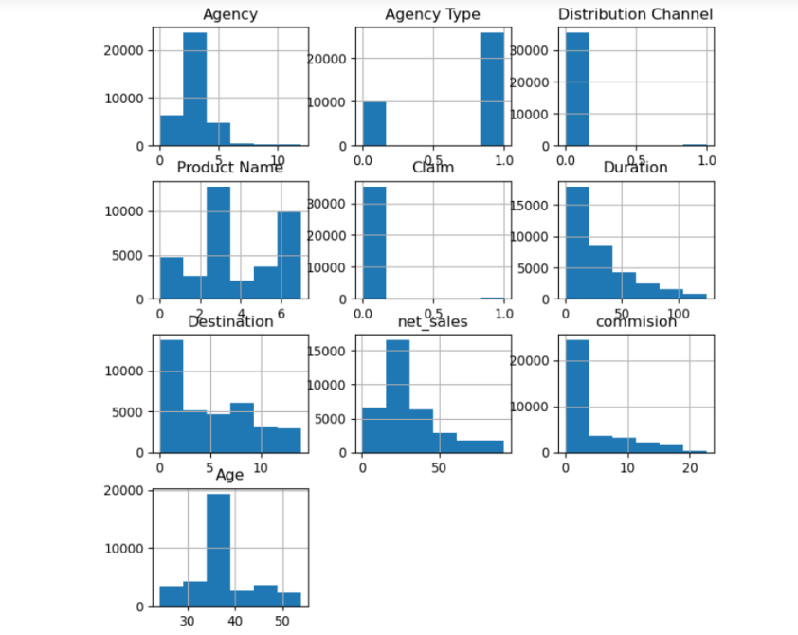
Data Visualization
Histograms help in examining the shape, spread, and central tendency of a dataset. By displaying the frequency of values within different bins or intervals, histograms provide insights into the underlying distribution of the data, such as whether it is skewed, symmetrical, or bimodal.
travels.hist(bins=6,figsize=(8,8))
plt.show()

Slide 7
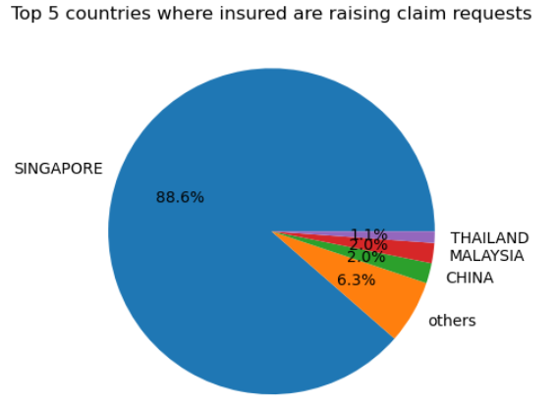
Pie Chart
I am cheacking Top 5 countries where insured are raising claim requests.
yes_claim=new_df.loc[new_df['Claim']=='Yes']
destination_claim= yes_claim.groupby(by=["Destination"]).size().reset_index(name="counts")
df_n_largest=destination_claim.nlargest(10,['counts'])
plt.pie(df_n_largest['counts'], labels=df_n_largest['Destination'], autopct='%1.1f%%')
plt.title('Top 5 countries where insured are raising claim requests')
plt.show()

Slide 8
Model Comparison
My target Variable is commission which is a Continuous data so I am using Linear Regression algorithm .Here I got accuracy of train data is 95.36 and test data is 95.12 from Linear regrestion
I got accuracy of Train and test ( 99.95 and 99.88) from Decision Tree.
I got accuracy of Train and test ( 99.94 and 99.90) from Random Forest.
Finally, i got best accuracy from Random Forest without overfiting and underfiting as well.

Slide 9

By Priyanka

